Slide 1
Entity framework
Let’s grow 13 September 2022

Slide 2
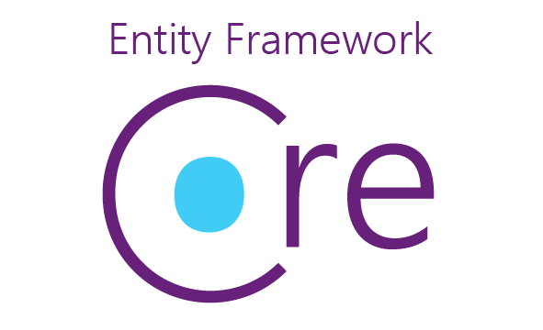

Slide 3
Entity Framework Core
Entity Framework (EF) Core is a lightweight, extensible, open source and cross-platform version of the popular Entity Framework data access technology.
EF Core can serve as an object-relational mapper (O/RM), which:
Enables .NET developers to work with a database using .NET objects.
Eliminates the need for most of the data-access code that typically needs to be written.

Slide 4
The model
With EF Core, data access is performed using a model. A model is made up of entity classes and a context object that represents a session with the database. The context object allows querying and saving data. For more information, see Creating a Model.
EF supports the following model development approaches:
Generate a model from an existing database.
Hand code a model to match the database.
Once a model is created, use EF Migrations to create a database from the model. Migrations allow evolving the database as the model changes.

Slide 5
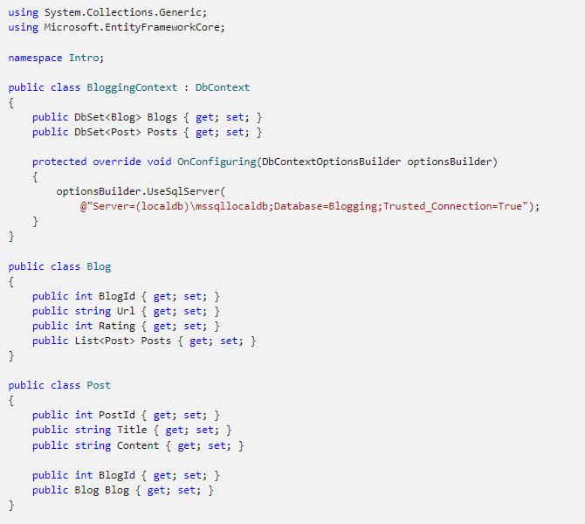

Slide 6
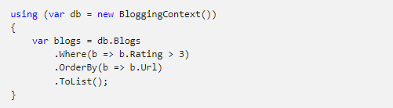
Querying
Instances of your entity classes are retrieved from the database using Language Integrated Query (LINQ).

Slide 7
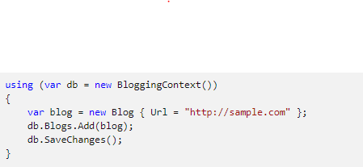
Saving data
Data is created, deleted, and modified in the database using instances of your entity classes.

Slide 8
EF O/RM considerations
While EF Core is good at abstracting many programming details, there are some best practices applicable to any O/RM that help to avoid common pitfalls in production apps:
Intermediate-level knowledge or higher of the underlying database server is essential to architect, debug, profile, and migrate data in high performance production apps. For example, knowledge of primary and foreign keys, constraints, indexes, normalization, DML and DDL statements, data types, profiling, etc.
Functional and integration testing: It's important to replicate the production environment as closely as possible to:
Find issues in the app that only show up when using a specific versions or edition of the database server.
Catch breaking changes when upgrading EF Core and other dependencies. For example, adding or upgrading frameworks like ASP.NET Core, OData, or AutoMapper. These dependencies can affect EF Core in unexpected ways.
Performance and stress testing with representative loads. The naïve usage of some features doesn't scale well. For example, multiple collections Includes, heavy use of lazy loading, conditional queries on non-indexed columns, massive updates and inserts with store-generated values, lack of concurrency handling, large models, inadequate cache policy.

Slide 9
EF O/RM considerations
Security review: For example, handling of connection strings and other secrets, database permissions for non-deployment operation, input validation for raw SQL, encryption for sensitive data.
Make sure logging and diagnostics are sufficient and usable. For example, appropriate logging configuration, query tags, and Application Insights.
Error recovery. Prepare contingencies for common failure scenarios such as version rollback, fallback servers, scale-out and load balancing, DoS mitigation, and data backups.
Application deployment and migration. Plan out how migrations are going to be applied during deployment; doing it at application start can suffer from concurrency issues and requires higher permissions than necessary for normal operation. Use staging to facilitate recovery from fatal errors during migration. For more information, see Applying Migrations.
Detailed examination and testing of generated migrations. Migrations should be thoroughly tested before being applied to production data. The shape of the schema and the column types cannot be easily changed once the tables contain production data. For example, on SQL Server, nvarchar(max) and decimal(18, 2) are rarely the best types for columns mapped to string and decimal properties, but those are the defaults that EF uses because it doesn't have knowledge of your specific scenario.

Slide 10
Getting Started with EF Core
In this tutorial, you create a .NET Core console app that performs data access against a SQLite database using Entity Framework Core.
You can follow the tutorial by using Visual Studio on Windows, or by using the .NET Core CLI on Windows, macOS, or Linux.
https://docs.microsoft.com/en-us/ef/core/get-started/overview/first-app?tabs=visual-studio

Slide 11
Razor Pages with Entity Framework Core in ASP.NET Core - Tutorial 1 of 8
This is the first in a series of tutorials that show how to use Entity Framework (EF) Core in an ASP.NET Core Razor Pages app. The tutorials build a web site for a fictional Contoso University. The site includes functionality such as student admission, course creation, and instructor assignments. The tutorial uses the code first approach.
https://docs.microsoft.com/en-us/aspnet/core/data/ef-rp/intro?view=aspnetcore-6.0&tabs=visual-studio
Notes:
https://docs.microsoft.com/en-us/aspnet/core/data/ef-rp/intro?view=aspnetcore-6.0&tabs=visual-studio

Slide 12
https://docs.microsoft.com/en-us/ef/core/what-is-new/ef-core-7.0/plan

Slide 13
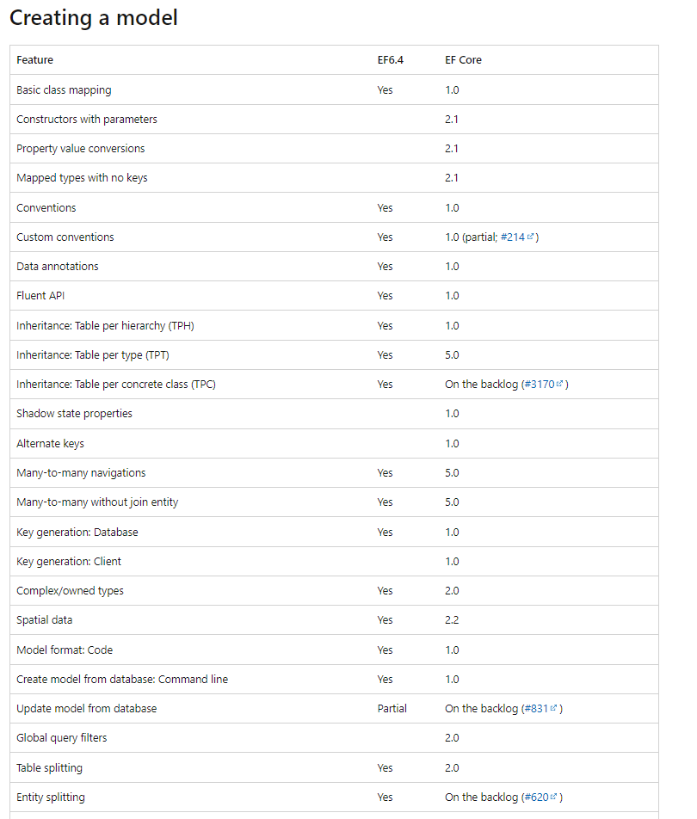
EF6 vs EF Core

Slide 14
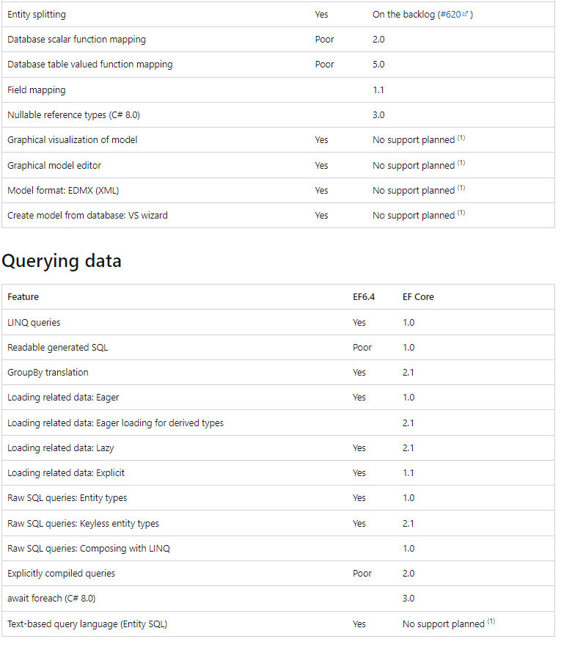

Slide 15
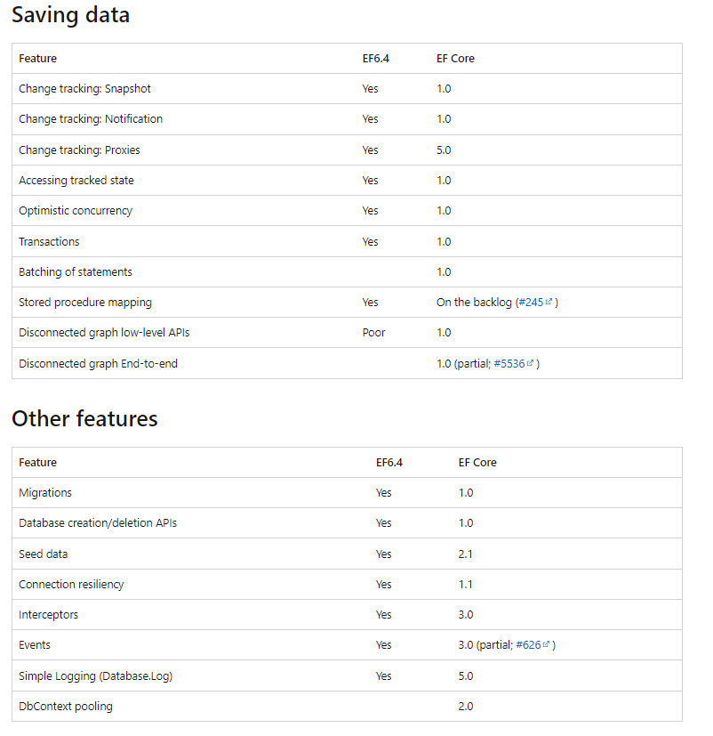

Slide 16
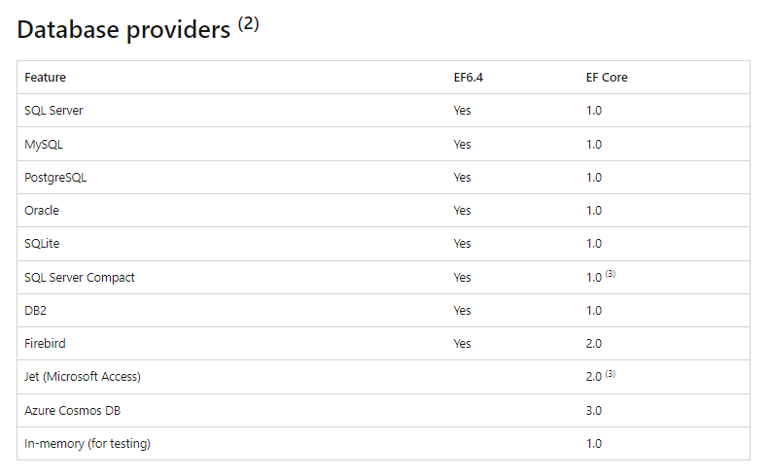

Slide 17
Understanding EF core
Entity Framework Core is an object-relational mapper. ORMs provide a layer between the domain model you implement in code and the database. EF Core is a data access API that allows you to interact with the database using .NET POCOs (Plain Old CLR Objects) and strongly-typed LINQ. This allows you to spend less time translating requests to and from the database and writing SQL, giving you more time to focus on important business logic.
With EF Core, the database is abstracted behind .NET POCOs . As a result, you can focus on your code and EF Core handles direct interaction with the underlying database.

Slide 18
Ef core capabilities
With EF Core, you can:
Load data as C# objects (entities).
Add, modify, and delete data by calling methods on those entities.
Map multiple database tables to a single C# entity.
Handle concurrency issues that arise when multiple users simultaneously attempt to update the same record.
Use strongly typed Language Integrated Query (System.Linq) syntax to query the database.
Access multiple databases including SQL Server, SQLite, Azure Cosmos DB, PostgreSQL, MySQL, and more.
Build your domain model from an existing database.
Manage your database schema based on your domain model.
Commit changes to complex, deep and/or wide object graphs of related entities with a single method call.

Slide 19
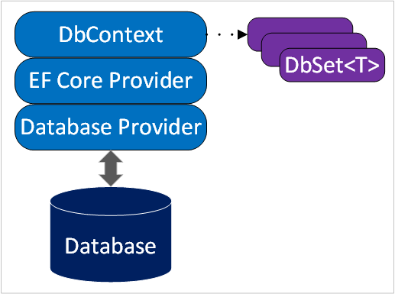
Ef core architecture
The DbContext is a special class that represents a unit of work and provides methods to configure options, connection strings, logging, and the model used to map your domain to the database. Classes deriving from DbContext:
Represent an active session with the database.
Save and query instances of entities.
Include properties of type DbSet<T> representing tables in the database.
The EF Core Provider translates object graph changes to SQL.

Slide 20
Ef core architecture
The Database Provider:
Is a plug-in library designed for a specific database engine, such as SQL Server, Azure Cosmos DB, or PostgreSQL.
Translates method calls and LINQ queries to the database's native SQL dialect.
Extends EF Core to enable functionality that's unique to the database engine.

Slide 21
Manage database schemas
EF Core provides two primary ways of keeping your EF Core model and database schema in sync. To choose between the two, decide whether your EF Core model or the database schema is the source of truth.
Reverse engineering (Database as the source of truth)
Reverse engineering is the process of scaffolding entity model classes and a DbContext class based on a database schema. This approach is often used with existing or shared databases that are managed by a DBA.

Slide 22
Manage database schemas
Migrations (Model as the source of truth)
In real world projects, data models change as app features get implemented. As new entities are added and removed, the database schemas need to be changed accordingly. EF Core migrations provide a way to incrementally update the database schema to keep it in sync with the application's data model while preserving existing data in the database.
When a data model change is introduced, the developer uses EF Core tools to add a corresponding migration. EF Core compares the current model against a snapshot of the old model to determine the differences. C# code to implement the changes is generated. The C# files can be modified for custom behaviors or to seed data, and are tracked in your project's source control like any other source file.
Once a new migration has been generated, it can be applied to a database in various ways. EF Core records all applied migrations in a special history table. The history table keeps a record of which migrations have been applied.

Slide 23
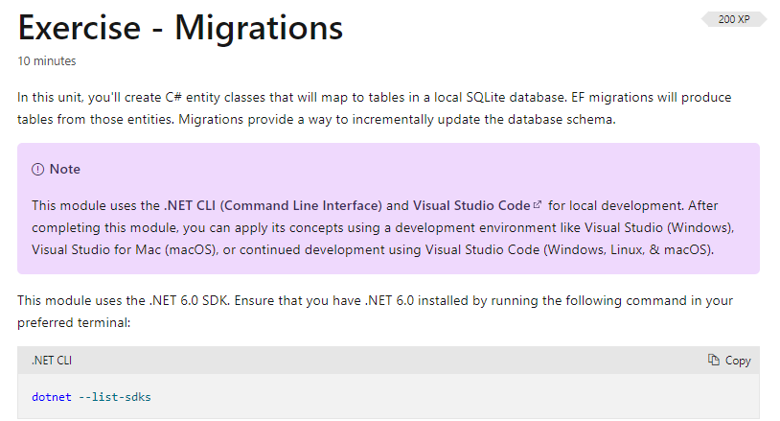
Exercise - migrations
https://docs.microsoft.com/en-us/training/modules/persist-data-ef-core/3-migrations

Slide 24
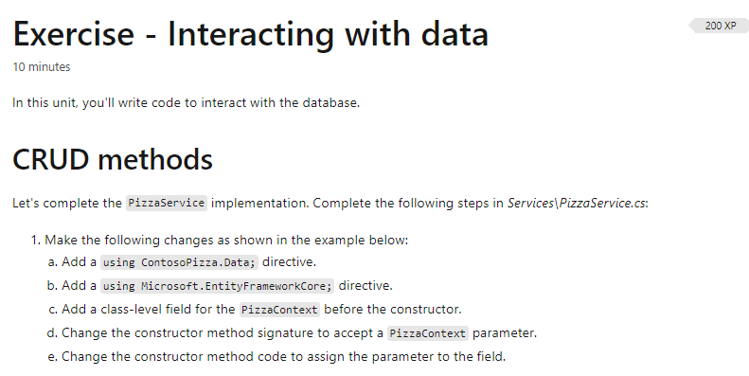
Exercise - Interacting with data
https://docs.microsoft.com/en-us/training/modules/persist-data-ef-core/4-interacting-data

Slide 25
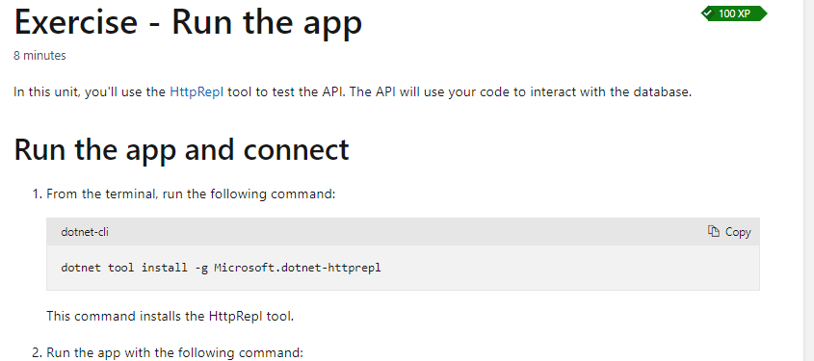
Exercise - Run the app
https://docs.microsoft.com/en-us/training/modules/persist-data-ef-core/5-test-db-operations

Slide 26
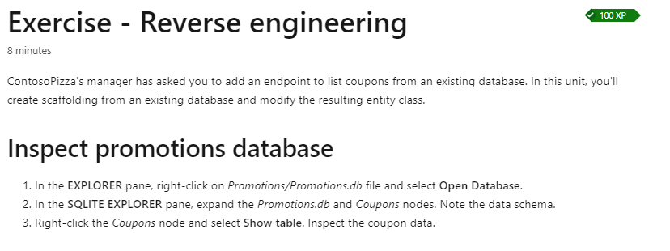
Exercise - Reverse engineering
https://docs.microsoft.com/en-us/training/modules/persist-data-ef-core/6-reverse-engineering

Slide 27
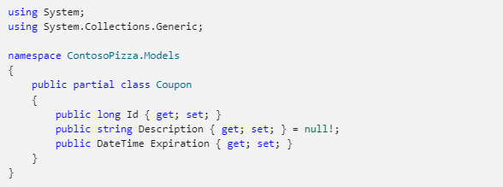
Reverse engineering - partial classes
Every time you create new scaffolded files after the database changed the old files are overwritten, so we lose all the changes we made in them. We can use a partial class for our own code

Slide 28
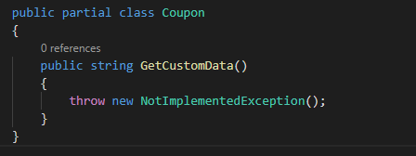
Reverse engineering - partial classes
A new method is added with a partial class, which won’t be overwritten!

Slide 29
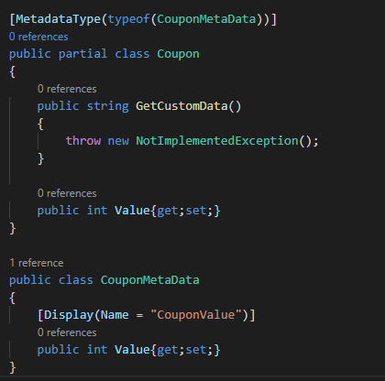
Reverse engineering - attributes

Slide 30
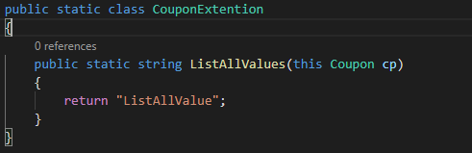
Extention methods
With this you can use myCoupon.ListAllValue(). Remember the method is not actually part of the class, so it can’t access private properties, etc.

Slide 31
New in ef core 6.0
Temporal Tables
Migration Bundles
Compiled Models
Improvement to scaffolding

Slide 32
SQL Server temporal tables
SQL Server temporal tables automatically keep track of all data ever stored in a table, even after that data has been updated or deleted. This is achieved by creating a parallel "history table" into which timestamped historical data is stored whenever a change is made to the main table. This allows historical data to be queried, such as for auditing, or restored, such as for recovery after accidental mutation or deletion.
EF Core now supports:
The creation of temporal tables using Migrations
Transformation of existing tables into temporal tables, again using Migrations
Querying historical data
Restoring data from some point in the past

Slide 33

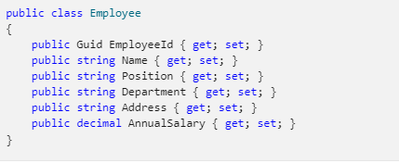
Configuring a temporal table
The model builder can be used to configure a table as temporal. For example:
When using EF Core to create the database, the new table will be configured as a temporal table with the SQL Server defaults for the timestamps and history table. For example, consider an Employee entity type:

Slide 34
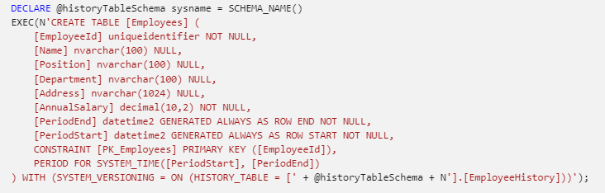
Configuring a temporal table
The temporal table created will look like this:
Notice that SQL Server creates two hidden datetime2 columns called PeriodEnd and PeriodStart. These "period columns" represent the time range during which the data in the row existed. These columns are mapped to shadow properties in the EF Core model, allowing them to be used in queries as shown later.

Slide 35
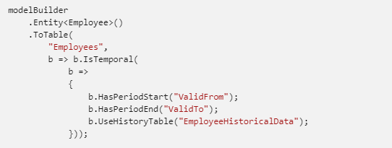
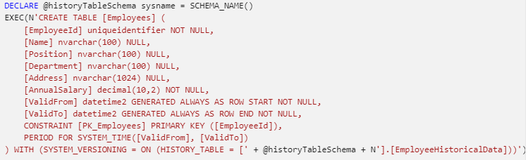
Configuring a temporal table
Notice also that an associated history table called EmployeeHistory is created automatically. The names of the period columns and history table can be changed with additional configuration to the model builder. For example:

Slide 36
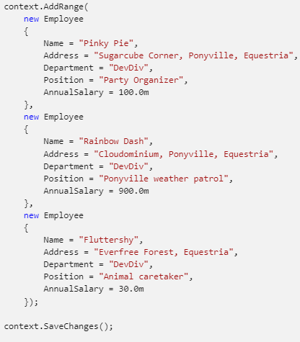
Using temporal tables
Most of the time, temporal tables are used just like any other table. That is, the period columns and historical data are handled transparently by SQL Server such that the application can ignore them. For example, new entities can be saved to the database in the normal way:

Slide 37

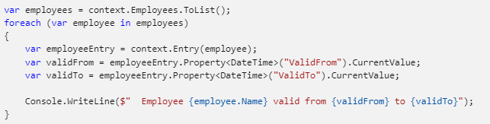

Using temporal tables
This data can then be queried, updated, and deleted in the normal way. For example:
Also, after a normal tracking query, the values from the period columns of the current data can be accessed from the tracked entities. For example:

Slide 38
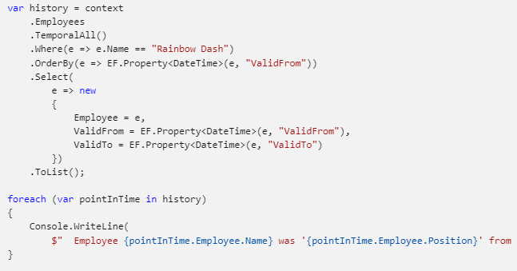
Querying historical data
For example, after making some updates and deletes to our data, we can run a query using TemporalAll to see the historical data:
Notes:
https://docs.microsoft.com/en-us/sql/relational-databases/tables/temporal-tables#how-do-i-query-temporal-data

Slide 39
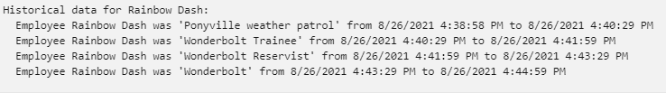
Querying historical data
Notice how the EF.Property method can be used to access values from the period columns. This is used in the OrderBy clause to sort the data, and then in a projection to include these values in the returned data.
This query brings back the following data:

Slide 40
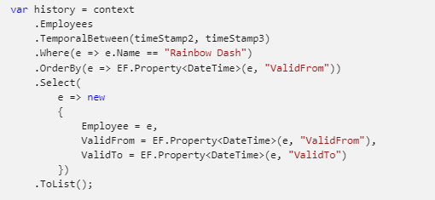
Querying historical data
Similar queries can be written using TemporalFromTo, TemporalBetween, or TemporalContainedIn. For example:

Slide 41
Querying historical data
EF Core supports queries that include historical data through several new query operators:
TemporalAsOf: Returns rows that were active (current) at the given UTC time. This is a single row from the current table or history table for a given primary key.
TemporalAll: Returns all rows in the historical data. This is typically many rows from the history table and/or the current table for a given primary key.
TemporalFromTo: Returns all rows that were active between two given UTC times. This may be many rows from the history table and/or the current table for a given primary key.
TemporalBetween: The same as TemporalFromTo, except that rows are included that became active on the upper boundary.
TemporalContainedIn: Returns all rows that started being active and ended being active between two given UTC times. This may be many rows from the history table and/or the current table for a given primary key.

Slide 42
Migration Bundles
EF Core migrations are used to generate database schema updates based on changes to the EF model. These schema updates should be applied at application deployment time, often as part of a continuous integration/continuous deployment (C.I./C.D.) system.
EF Core now includes a new way to apply these schema updates: migration bundles. A migration bundle is a small executable containing migrations and the code needed to apply these migrations to the database.
https://devblogs.microsoft.com/dotnet/introducing-devops-friendly-ef-core-migration-bundles/

Slide 43
Compiled models
Compiled models can improve EF Core startup time for applications with large models. A large model typically means 100s to 1000s of entity types and relationships.
Startup time means the time to perform the first operation on a DbContext when that DbContext type is used for the first time in the application. Note that just creating a DbContext instance does not cause the EF model to be initialized. Instead, typical first operations that cause the model to be initialized include calling DbContext.Add or executing the first query.

Slide 44

Compiled models
Compiled models are created using the dotnet ef command-line tool. Ensure that you have installed the latest version of the tool before continuing.
A new dbcontext optimize command is used to generate the compiled model. For example:
The --output-dir and --namespace options can be used to specify the directory and namespace into which the compiled model will be generated. For example:

Slide 45

Compiled models
The output from running this command includes a piece of code to copy-and-paste into your DbContext configuration to cause EF Core to use the compiled model. For example:

Slide 46
Compiled models - limitations
Compiled models have some limitations:
Global query filters are not supported.
Lazy loading and change-tracking proxies are not supported.
Custom IModelCacheKeyFactory implementations are not supported. However, you can compile multiple models and load the appropriate one as needed.
The model must be manually synchronized by regenerating it any time the model definition or configuration change.
Because of these limitations, you should only use compiled models if your EF Core startup time is too slow. Compiling small models is typically not worth it.
Notes:
https://github.com/dotnet/efcore/issues/24897
https://github.com/dotnet/efcore/issues/24902
https://github.com/dotnet/efcore/issues/24894

Slide 47
Compiled models - benchmarks
he model in the GitHub repo referenced above contains 449 entity types, 6390 properties, and 720 relationships. This is a moderately large model. Using BenchmarkDotNet to measure, the average time to first query is 1.02 seconds on a reasonably powerful laptop. Using compiled models brings this down to 117 milliseconds on the same hardware. An 8x to 10x improvement like this stays relatively constant as the model size increases.

Slide 48
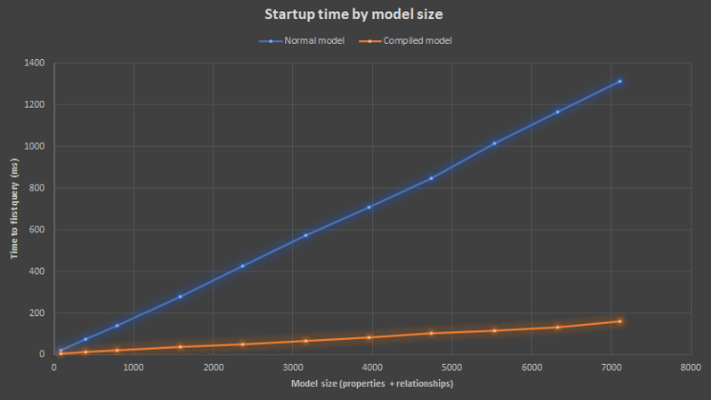
Compiled models - benchmarks

Slide 49
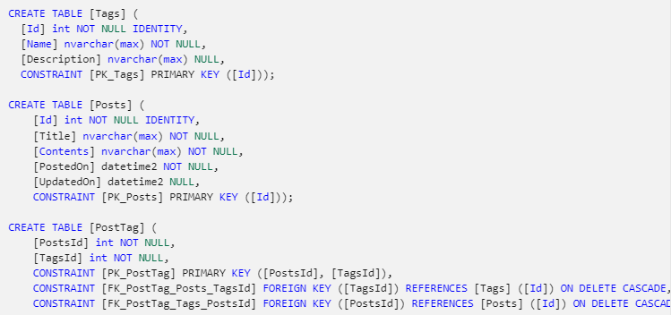
Improvements to scaffolding from an existing database - Scaffolding many-to-many relationships
EF Core 6.0 detects simple join tables and automatically generates a many-to-many mapping for them. For example, consider tables for Posts and Tags, and a join table PostTag connecting them:

Slide 50
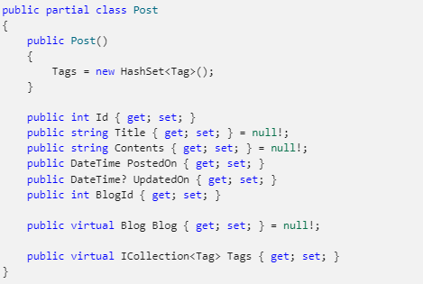
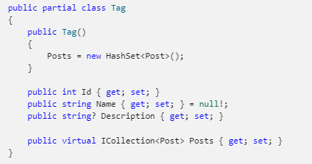
Improvements to scaffolding from an existing database - Scaffolding many-to-many relationships
These tables can be scaffolded from the command line. For example:
dotnet ef dbcontext scaffold "Data Source=(localdb)\MSSQLLocalDB;Initial Catalog=BloggingWithNRTs" Microsoft.EntityFrameworkCore.SqlServer

Slide 51
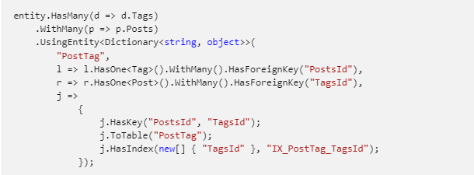
Improvements to scaffolding from an existing database - Scaffolding many-to-many relationships
No class for the PostTag table is generated. Instead, configuration for a many-to-many relationship is scaffolded:

Slide 52
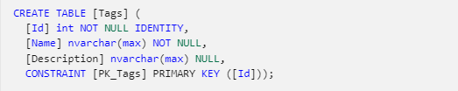
Scaffold C# nullable reference types
EF Core 6.0 now scaffolds an EF model and entity types that use C# nullable reference types (NRTs). NRT usage is scaffolded automatically when NRT support is enabled in the C# project into which the code is being scaffolded.
For example, the following Tags table contains both nullable non-nullable string columns:

Slide 53
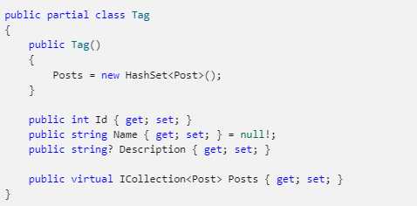
Scaffold C# nullable reference types
This results in corresponding nullable and non-nullable string properties in the generated class:

Slide 54
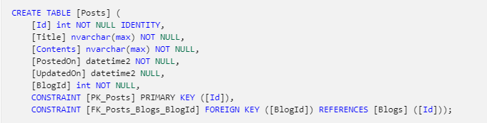
Scaffold C# nullable reference types
Similarly, the following Posts tables contains a required relationship to the Blogs table:

Slide 55
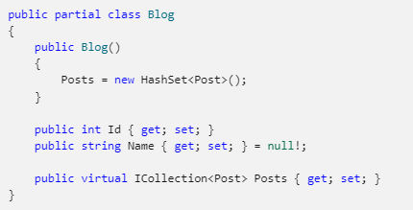
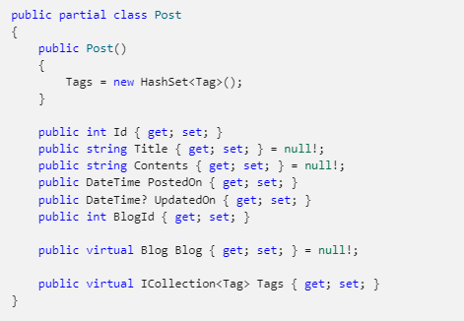
Scaffold C# nullable reference types
This results in the scaffolding of non-nullable (required) relationship between blogs:

Slide 56
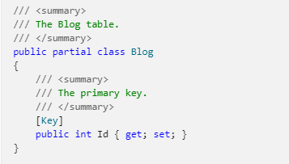
Database comments are scaffolded to code comments
Comments on SQL tables and columns are now scaffolded into the entity types created when reverse-engineering an EF Core model from an existing SQL Server database.

Slide 57
More new features of EF core 6.0
https://docs.microsoft.com/en-us/ef/core/what-is-new/ef-core-6.0/whatsnew

Slide 58
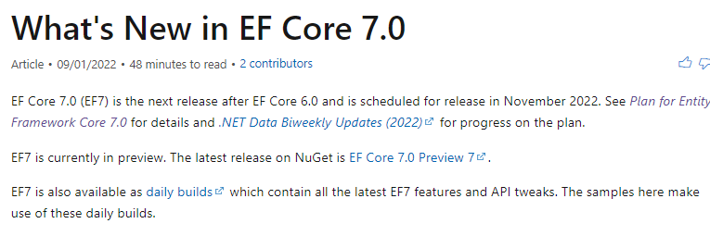
Plan for Entity Framework Core 7.0
https://docs.microsoft.com/en-us/ef/core/what-is-new/ef-core-7.0/plan
https://docs.microsoft.com/en-us/ef/core/what-is-new/ef-core-7.0/whatsnew?source=recommendations

Slide 59
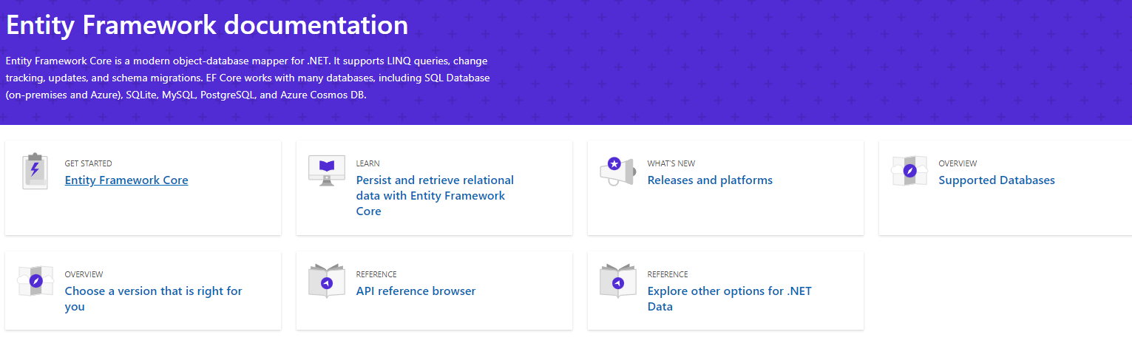
Entity framework documentation
https://docs.microsoft.com/nl-nl/ef/

